Slide 1
System-level AI Safety: Why So Challenging? - From a Formal Perspective
Changjian Zhang
Notes:
Even though, some of our discussions should be applicable in general AI systems. However, we mainly focus on self-driving cars.

Slide 2
Formal Analysis for Software
Given a model of the environment and system,
Model check or prove some given property.
Compositional reasoning for system-level properties.
Notes:
In the past 2 years, I mainly worked on formal analysis for software systems, especially verifying a design is safe and robust. We have a paper on formally define software robustness, and an ICSE submission about automatically robustifying a system design.
In the context of those research, we often pretend we have the formal specification of the system either specified by the developers or extracted from the code. We then use model checking or theorem prover to verify some give property. When we are dealing with a large system with multiple components, we can leverage compositional reasoning that merges the verification results for each component to conclude some system-level property.
However, with more and more systems are AI-enabled, especially ML enabled, this brings new challenges to the formal community. One crucial issue is that we don’t have a way to specify the behavior of a ML component.

Slide 3





Formal Analysis for Machine Learning
Recent Trend: formal spec inference from ML models
E.g., Linear constraint solving
Apply compositional reasoning?
Assume-guarantee style reasoning
Heterogenous models
camera
Promising but Hard!
Image Preprocess
ML Obstacle detection
Planner
$$A_{1}⇒G_{1}$$
$$A_{2}⇒G_{2}$$
$$A_{3}⇒G_{3}$$
$$A_{4}⇒G_{4}$$
Notes:
Recent trend in formal analysis for ML is to extract or infer an approximation of a given ML model, e.g., it could be a linear constraints model. Then, with the formal specification of the model, we can then go back to apply compositional reasoning approaches. E.g., lets assume a self-driving car system which has a camera to capture images, after some preprocess component, it uses a ML component to detect obstacles, then finally, it uses a non-ml component to do planning. In an assume-guarantee style reasoning, we want to generate a assume-guarantee pair for each component, e.g., when A3 is satisfied for the ML component, then some G3 should be satisfied. Then, if G3 implies A4, then the guarantee G4 for the planner is also satisfied.
This approach is promising but also hard. E.g., one issue is we have heterogenous models, the ML model may be represented by some linear constraints, the planner might be a state machine. How should we integrate their verification results.

Slide 4
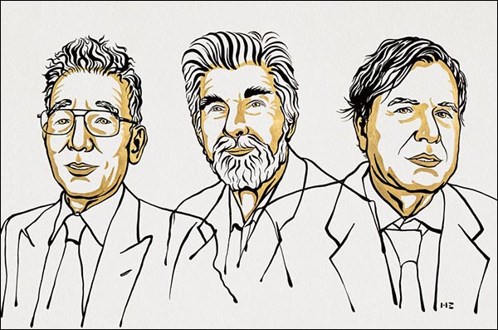
Errors, Deviations, and Robustness
Everything can go wrong!
Hardware sensors always have noise.
Machine learning models can never be 100% accurate, may also be biased and vulnerable to attacks; Real data may be different from training data.
Software programs contains design faults and implementation bugs.
How an error/deviation in the env/system propagate through the system causing the system-level property to be violated?
Complex system? Worth a Nobel Prize!
2021 Physics Nobel Laureates. Pictured from left to right: Syukuro Manabe, Klaus Hasselmann, and Giorgio Parisi.
https://www.aps.org/publications/apsnews/202111/nobel2021.cfm
Notes:
In addition, we are interested in how the errors or deviations in the environment or system can affect the correctness of the system. In a system like a self-driving car, everything can go wrong! ...
We want to answer the question that how these errors propagate through the system causing the system-level property to be violated? Also, how can we measure the robustness of the entire system?
However, after some literature review, I find this system-level view lacks attention from the community. The ML community focus on training robust models, the SE community focus on building robust planners. However, best components do not imply the best system. It’s not a trivial task to reason their combination.
This reminds me complex system which won this year’s nobel prize where you have non-linear interactions among multiple components which make it extremely hard to predict the system behavior.

Slide 5
Current Research Focus
ML Community: train a “robust” model,
E.g., be robust against noise, distortion, adversarial attack
SE Community: be robust against/adaptive to uncertainty from the environment
Best components imply best system?

Slide 6
A Formal Attempt
An attempt to:
Build a formal basis for describing the problem.
Formally classify different errors in the system.
Provide a formal theory to integrate existing work and guide future research.
Notes:
So we are working on a formal attempt to first, describe the problem formally; second, formally classify the errors in the system; and finally, provide a formal theory to integrate existing work and guide future research.

Slide 7




An Abstract System Structure
A self-driving car:
One or more sensors to make observations,
One or more ML models to detect obstacles, traffic signs, etc,
A software to generate control.
$$Perception$$
$$ML model$$
$$Controller$$
$$Observation$$
$$Plant$$
$$(car and env)$$
Notes:
We limit our scope to control systems. For example, consider a self-driving car system, we say the plant is the agent we want to control including the ego vehicle and the surrounding environment. It uses some sensors to make observations, which we call the observation module, one or more ML models to detect obstacles, traffic signs, which we call the perception module, and a controller to generate controls.

Slide 8

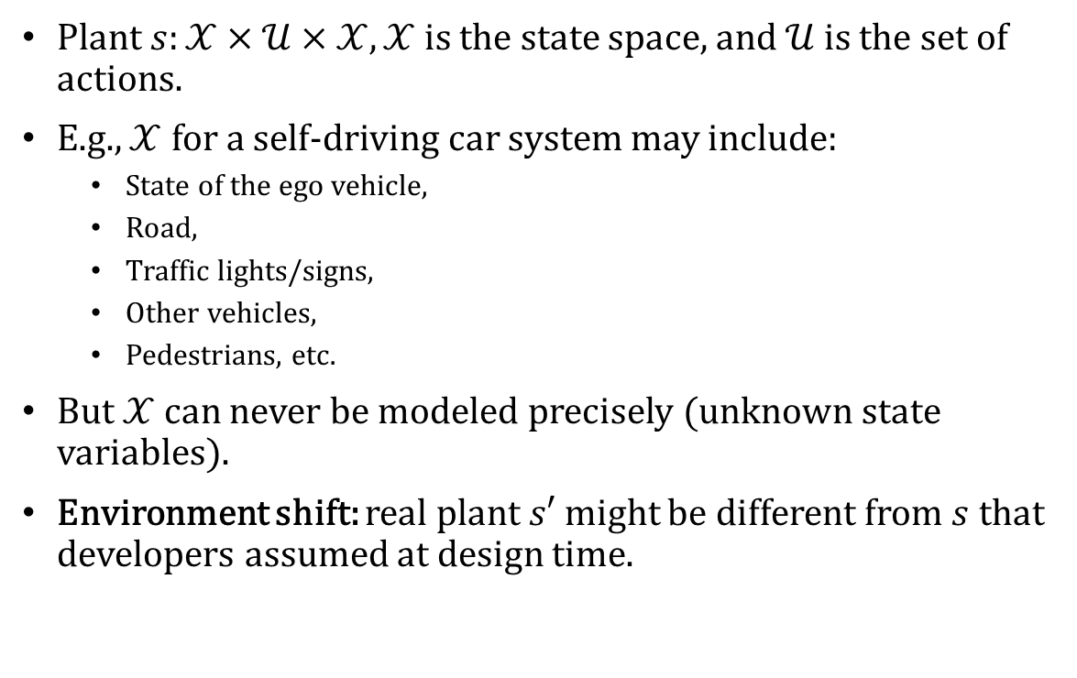
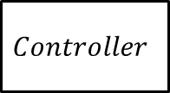
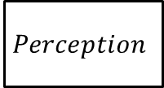
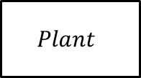

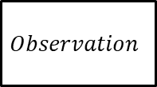
Problem context
Plant $s:𝒳×𝒰×𝒳, 𝒳$ is the state space, and $𝒰$ is the set of actions.
E.g., $𝒳$ for a self-driving car system may include:
State of the ego vehicle,
Road,
Traffic lights/signs,
Other vehicles,
Pedestrians, etc.
But $𝒳$ can never be modeled precisely (unknown state variables).
Environment shift: real plant $s′$ might be different from $s$ that developers assumed at design time.
$$Perception$$
$$Controller$$
$$Observation$$
$$x$$
$$Plant$$
$$s:𝒳×𝒰×𝒳$$
Notes:
The dynamics of the plant is modeled as a relation of X times U times X, where X is the state space and U is the set of actions, i.e., given a state of the plant and an action, it will non-deterministically transit to another state.
E.g., in a self-driving car system, X could include the state of the ego vehicle, the road, the traffic lights and signs, other vehicles, pedestrians and so on. But we can never model X precisely, because we may always have unknow variables. This brings uncertainty to the system.
Also, even for the given variables, the real environment may be different from what we expect, this introduces another kind of errors, and we call it environment shift.

Slide 9
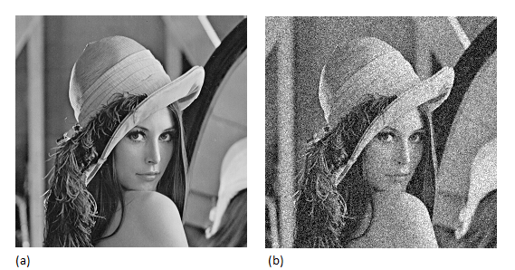

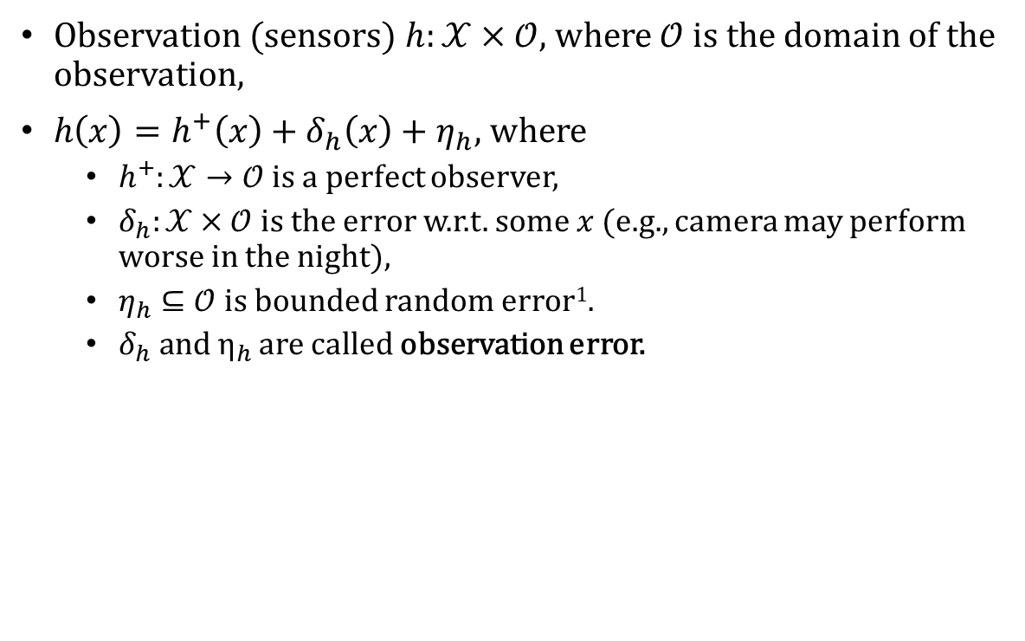





Observation
Observation (sensors) $h:𝒳×𝒪$, where $𝒪$ is the domain of the observation,
$h\left(x\right)=h^{+}\left(x\right)+δ_{h}\left(x\right)+η_{h}$, where
$h^{+}:𝒳→𝒪$ is a perfect observer,
$δ_{h}:𝒳×𝒪$ is the error w.r.t. some $x$ (e.g., camera may perform worse in the night),
$η_{h}⊆𝒪$ is bounded random error¹.
$δ_{h} \text{and} η_{h}$ are called observation error.
$$Perception$$
$$Controller$$
$$o$$
$$Observation$$
$$x$$
$$Plant$$
Random Noise from hardware
Ground truth
More noise in low light
$$h:𝒳×𝒪$$
$$s:𝒳×𝒰×𝒳$$
$$=$$
$$+$$
$$+$$
1: $δ_{h}\left(x\right)$ and $η_{h}$ are sets of values, so “+” should generate a set of values.
Notes:
The job of the observation module is to produce an observation of the current environment state. It is a relation from X to O where O is the domain of the observation, e.g., an image.
In particular, we represent it as a function h where … where …
Consider a camera taking a picture, the result from the camera is some groudtruth value, even though we often don’t know, plus some random noise from the hardware, and plus some more noise because of some particular environment state, e.g., in low light, we may observe more noise from the camera.

Slide 10
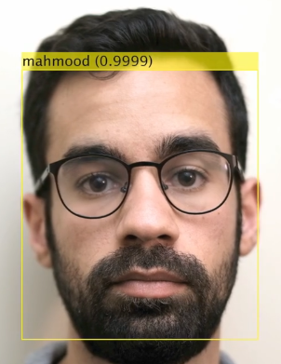
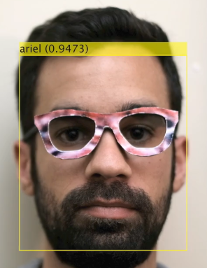
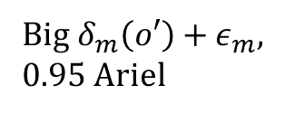
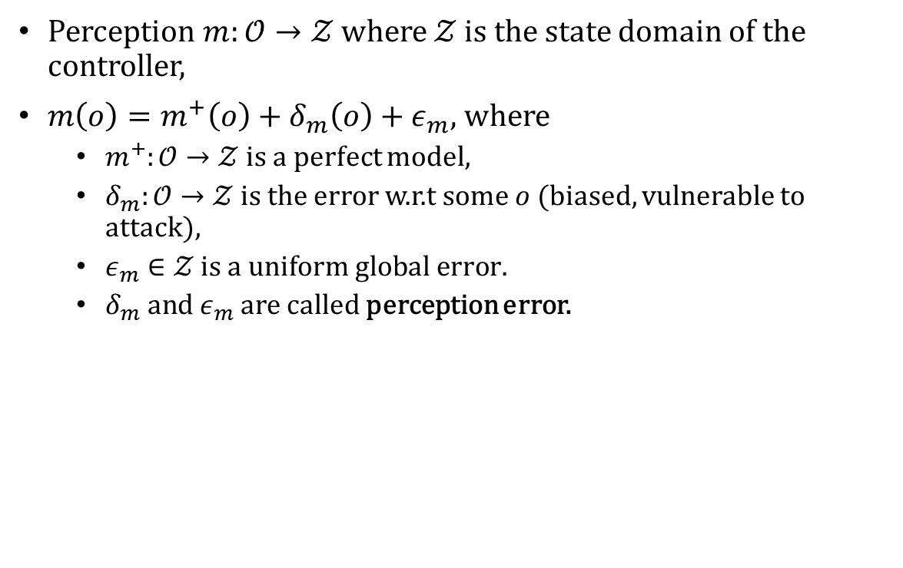



Perception
Perception $m:𝒪→𝒵$ where $𝒵$ is the state domain of the controller,
$m\left(o\right)=m^{+}\left(o\right)+δ_{m}\left(o\right)+ε_{m}$, where
$m^{+}:𝒪→𝒵$ is a perfect model,
$δ_{m}:𝒪→𝒵$ is the error w.r.t some $o$ (biased, vulnerable to attack),
$ε_{m}∈𝒵 \text{is} a \text{uniform} \text{global} \text{error}\text{.}$
$δ_{m} \text{and} ε_{m}$ are called perception error.
$$m:𝒪→𝒵$$
$$Perception$$
$$z$$
$$Controller$$
$$o$$
$$Observation$$
$$x$$
$$Plant$$
$$h:𝒳×𝒪$$
$$s:𝒳×𝒰×𝒳$$
Small $δ_{m}\left(o\right)+ε_{m}$,
0.99 Mahmood
Big $δ_{m}\left(o′\right)+ε_{m}$,
0.95 Ariel
https://users.ece.cmu.edu/~lbauer/papers/2016/ccs2016-face-recognition.pdf
Notes:
The job of the perception module is to map an observation to a state that the controller understands. We use Z to denote the state space of the controller. Then, similarly, the perception module can be modeled as a function m, where m(o) equals …
Where …
To understand the perception error, I use Lujo’s work on adversial ML as an example. From the two images below, we know this guy is 100% Mahmood. Given the input on the left, the model has small perception error. However, by changing the input a little bit, in this case, changing a pair of glasses, the model gives a completely wrong prediction.

Slide 11
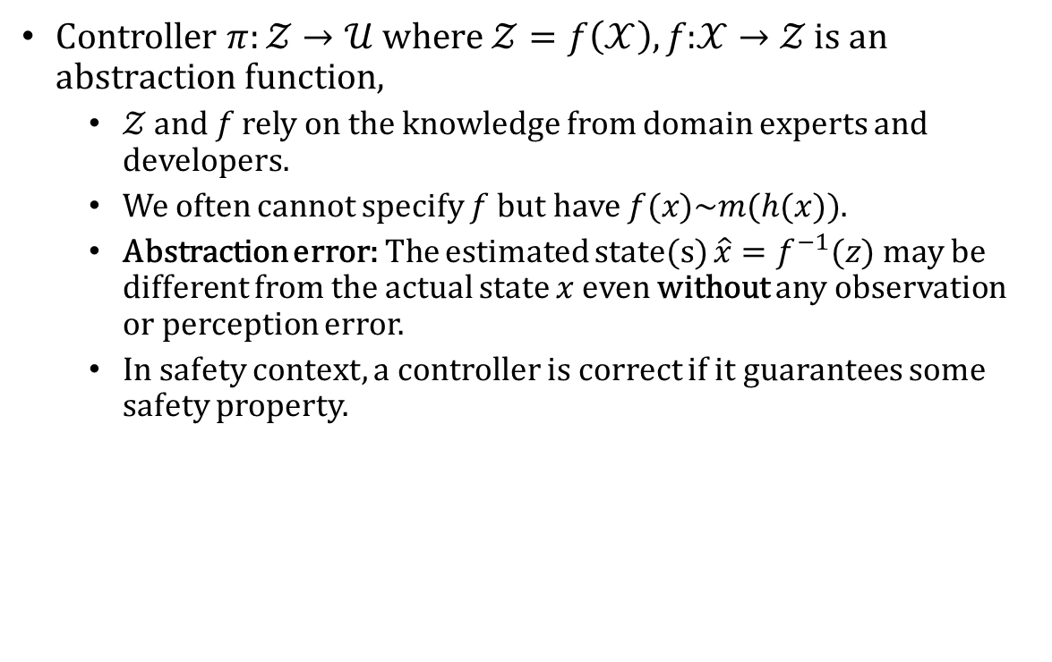


Controller
Controller $π:𝒵→𝒰 \text{where} 𝒵=f\left(𝒳\right),f\text{:}𝒳→𝒵 \text{is} \text{an} \text{abstraction} \text{function}$,
$𝒵 \text{and} f$ rely on the knowledge from domain experts and developers.
We often cannot specify $f$ but have $f(x)\sim m(h(x))$.
Abstraction error: The estimated state(s) $\hat{x}=f^{−1}(z)$ may be different from the actual state $x$ even without any observation or perception error.
In safety context, a controller is correct if it guarantees some safety property.
$$m:𝒪→𝒵$$
$$π:𝒵→𝒰$$
$$Perception$$
$$z$$
$$Controller$$
$$o$$
$$u$$
$$Observation$$
$$x$$
$$Plant$$
$$h:𝒳×𝒪$$
$$s:𝒳×𝒰×𝒳$$
Notes:
Finally, the job of the controller is to generate a control action u given the current state z. Mathematically, we can consider we have an abstraction function f, that maps a state x in the plant to a state z of the controller. However, in practice, the selection of Z highly relies on the knowledge of the domain experts and developers, and we cannot specify f because it is almost impossible to model X, i.e., the complete state space of the real world.
This brings another kind of errors, we call it abstraction error, in other words, the state of the controller does not always reflect the real state of the plant.
In safety context, the job of the controller is to guarantee some safety property, and we will see that all the errors I just mentioned make it hard to achieve this goal.

Slide 12
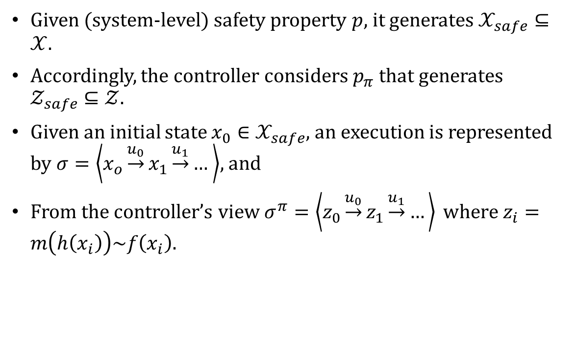
Safety property
Given (system-level) safety property $p$, it generates $𝒳_{safe}⊆𝒳$.
Accordingly, the controller considers $p_{π}$ that generates $𝒵_{safe}⊆𝒵$.
Given an initial state $x_{0}∈𝒳_{safe}$, an execution is represented by $σ=\left\langle x_{o}\underset{→}{u_{0}}x_{1}\underset{→}{u_{1}}… \right\rangle$, and
From the controller’s view $σ^{π}=\left\langle z_{0}\underset{→}{u_{0}}z_{1}\underset{→}{u_{1}}…\right\rangle \text{where} z_{i}=m\left(h\left(x_{i}\right)\right)\sim f\left(x_{i}\right)$.
$$m:𝒪→𝒵$$
$$π:𝒵→𝒰$$
$$Perception$$
$$z$$
$$Controller$$
$$o$$
$$u$$
$$Observation$$
$$x$$
$$Plant$$
$$h:𝒳×𝒪$$
$$s:𝒳×𝒰×𝒳$$
Notes:
Formally speaking, given a safety property P, it generates a safe region in X. However, since we cannot directly model X, the controller considers a corresponding safe region Z safe in Z. Given an initial state x0, an execution represents that the plant moves from x0 to x1 by action u0. And from the controller’s view, it moves from state z0 to z1 by action u0.

Slide 13
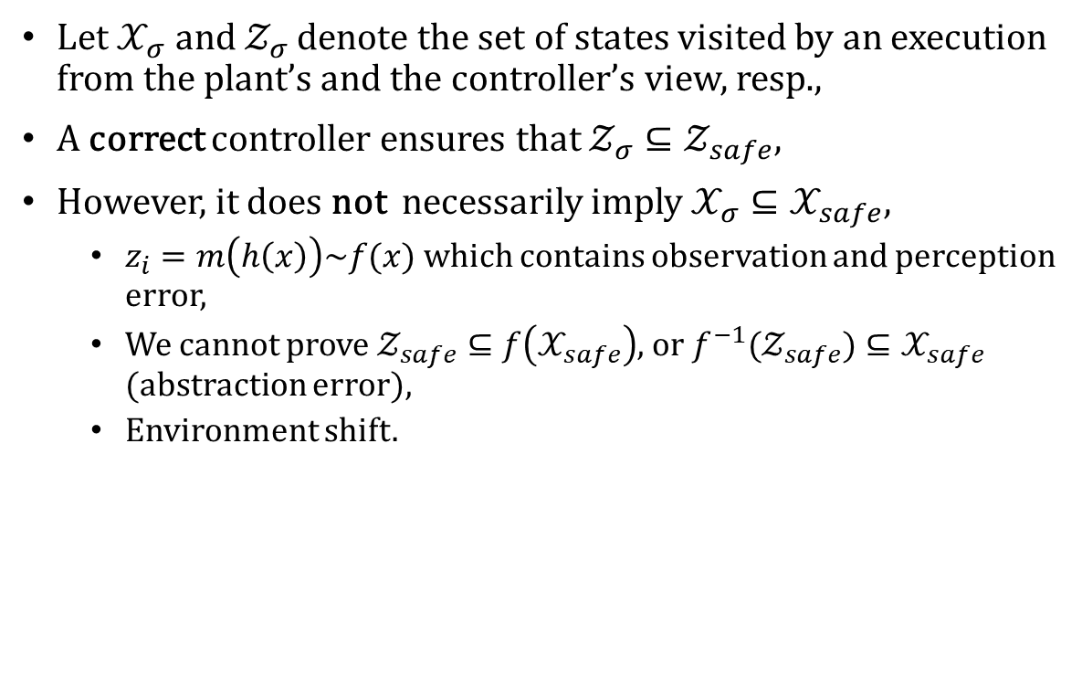
Safety property
Let $𝒳_{σ} \text{and} 𝒵_{σ}$ denote the set of states visited by an execution from the plant’s and the controller’s view, resp.,
A correct controller ensures that $𝒵_{σ}⊆𝒵_{safe}$,
However, it does not necessarily imply $𝒳_{σ}⊆𝒳_{safe}$,
$z_{i}=m\left(h\left(x\right)\right)\sim f(x)$ which contains observation and perception error,
We cannot prove $𝒵_{safe}⊆f\left(𝒳_{safe}\right)$, or ${f^{−1}(𝒵}_{safe})⊆𝒳_{safe}$ (abstraction error),
Environment shift.
$$m:𝒪→𝒵$$
$$π:𝒵→𝒰$$
$$Perception$$
$$z$$
$$Controller$$
$$o$$
$$u$$
$$Observation$$
$$x$$
$$Plant$$
$$h:𝒳×𝒪$$
$$s:𝒳×𝒰×𝒳$$
Notes:
From the controller’s view, a correct controller should always guarantee the system is moving in the range of Z safe. However, this does not imply the plant is actually safe because we have observation errors, perception errors. Also, we have abstraction error, that we cannot prove a safe state in Z is a safe state in X. Finally, we have environment shift, that the plant may not move to the state that the controller believes.

Slide 14










Safety property
$$z_{0}$$
$$z_{1}$$
$$z_{2}$$
$$m:𝒪→𝒵$$
$$π:𝒵→𝒰$$
$$Perception$$
$$z$$
$$Controller$$
Size of the range is affected by:
Observation error
Perception error
Abstraction error
Environment shift
$$𝒵_{safe}$$
$$o$$
$$u$$
$$𝒵$$
$$Observation$$
$$x$$
$$Plant$$
$$x_{1}$$
$$x_{0}$$
$$x_{2}$$
$$h:𝒳×𝒪$$
$$s:𝒳×𝒰×𝒳$$
$$𝒳_{safe}$$
$$𝒳$$
Notes:
To visualize this process, in this figure, the orange areas are the entire state space of X and Z, and the white areas indicate the safe regions.
So anytime the controller receives a state z, the plant could be in any state in a corresponding range. The size of the range is affected by the errors including observation, perception, abstraction errors, and environment shift.
So even though the controller may think the system is still safe, but the actual state of the plant might already be unsafe.

Slide 15
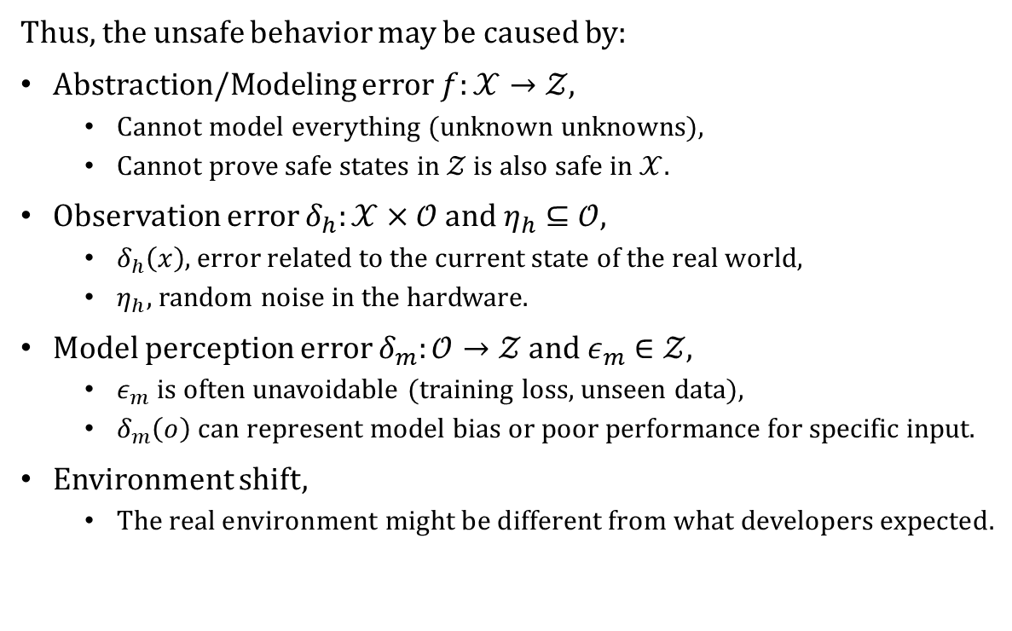
Causes of unsafe behaviors
Thus, the unsafe behavior may be caused by:
Abstraction/Modeling error $f:𝒳→𝒵$,
Cannot model everything (unknown unknowns),
Cannot prove safe states in $𝒵$ is also safe in $𝒳$.
Observation error $δ_{h}:𝒳×𝒪 \text{and} η_{h}⊆𝒪$,
$δ_{h}\left(x\right)$, error related to the current state of the real world,
$η_{h}$, random noise in the hardware.
Model perception error $δ_{m}:𝒪→𝒵 \text{and} ε_{m}∈𝒵$,
$ε_{m}$ is often unavoidable (training loss, unseen data),
$δ_{m}\left(o\right)$ can represent model bias or poor performance for specific input.
Environment shift,
The real environment might be different from what developers expected.
$$m:𝒪→𝒵$$
$$π:𝒵→𝒰$$
$$Perception$$
$$z$$
$$Controller$$
$$o$$
$$u$$
$$Observation$$
$$x$$
$$Plant$$
$$h:𝒳×𝒪$$
$$s:𝒳×𝒰×𝒳$$

Slide 16

Why So Challenging?!
All of them are unavoidable.
Infinite state spaces.
Unknown error functions ($δ_{h}, η_{h},δ_{m},ε_{m}$)
Lack of communication across disciplines.
Notes:
Here, we summarize why the problem is so challenging!
First, all of these errors are unavoidable, you always have errors in hardware, your ML model can never be 100% accurate, you may always encounter unknown unknowns in modeling.
Second, we often deal with infinite state spaces and it’s hard to measure the error functions.
Third, existing fault analysis methods are not enough, e.g., fault tree analysis often does not work, because errors are not simple logical combinations of propositions anymore. We have more non-linear interactions among multiple components.
Finally, I think we should bring more connections across disciplines. In my opinion, the problem that a lot of companies are facing is how to bring old-fashioned techniques to work together.

Slide 17
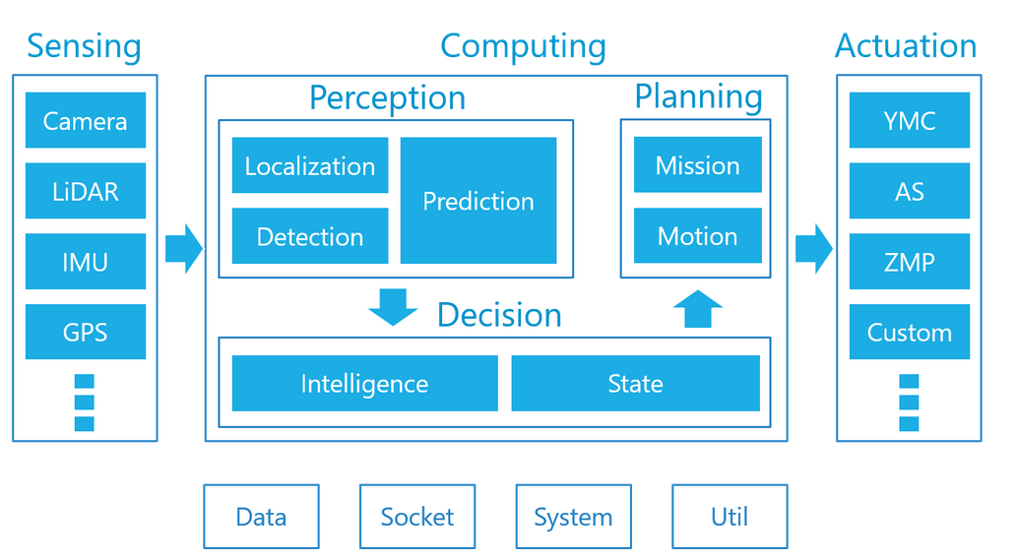
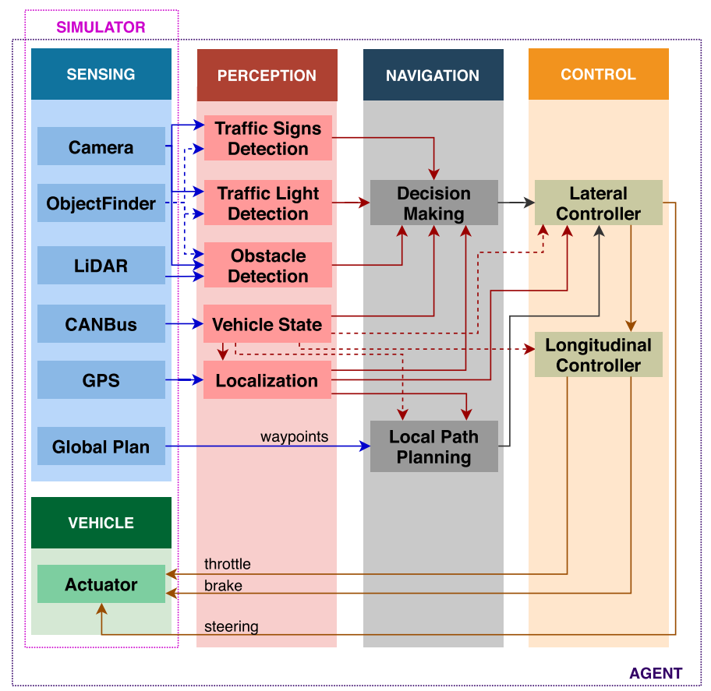
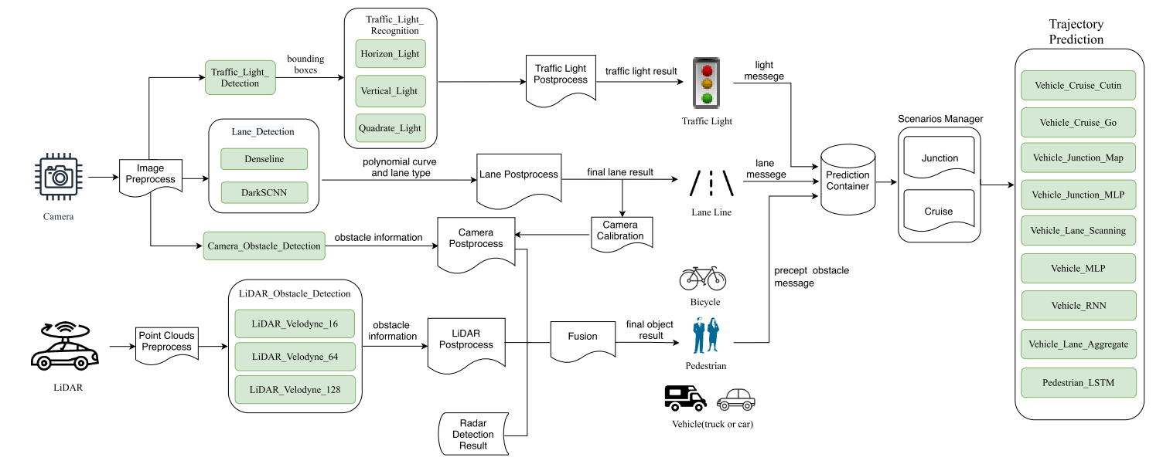
Real World Systems
Notes:
Moreover, the real systems are much more complex, the observation is done by multiple sensors like camera, lidar, gps. The perception is not one ML model, but a collection of models, each responsible for a particular task. Also, the controller is not a single model like an MDP, it consists of multiple software components. Finally, the control action from the software needs to be converted into signals for the brake, this may involve e.g., PID control from classic control theory.

Slide 18
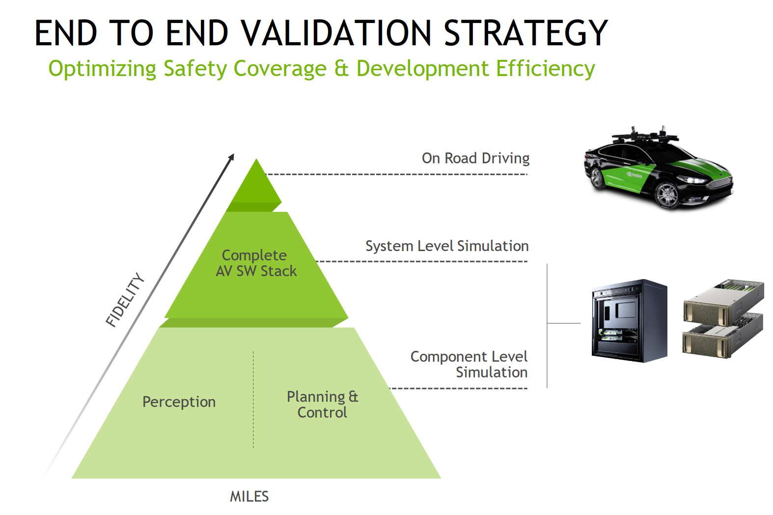
Ensuring Safety in Practice (NVIDIA)

Slide 19
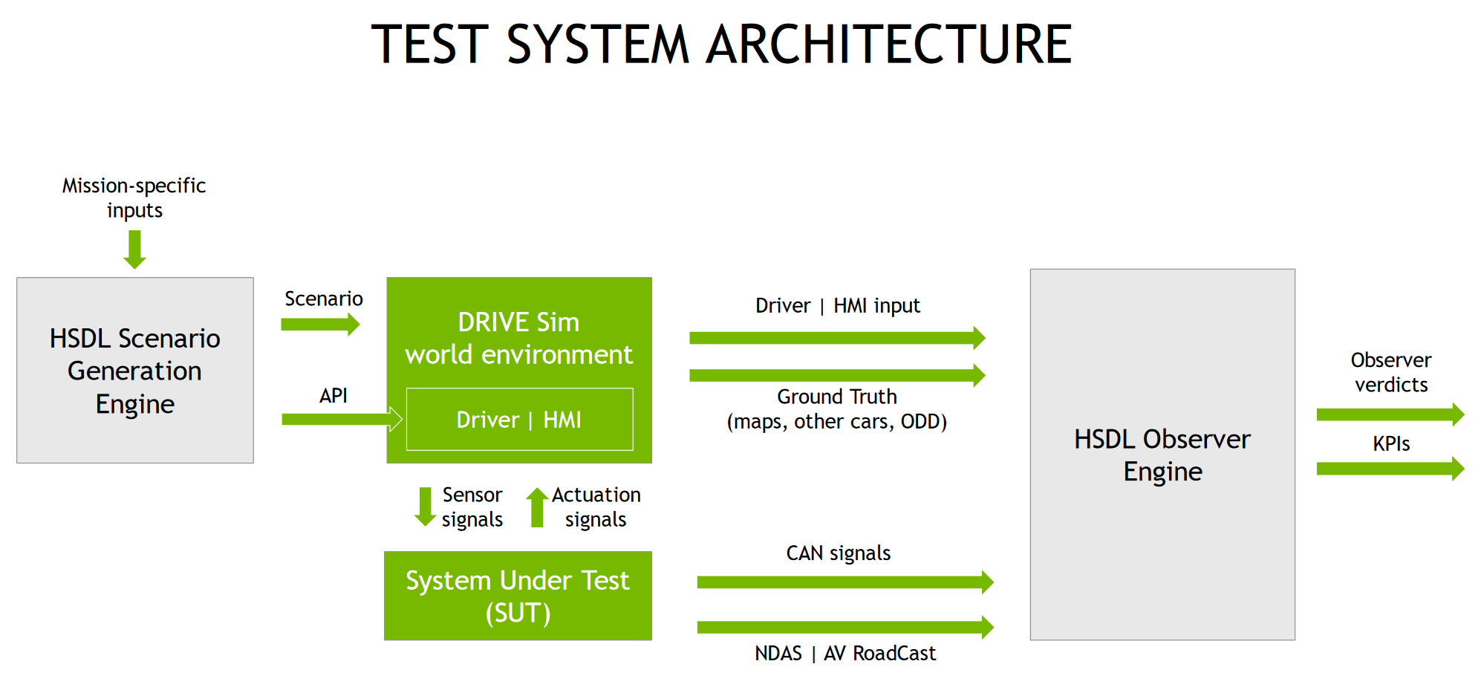
Ensuring Safety in Practice (NVIDIA)

Slide 20
Scenario-based Testing
How to design test scenarios?
What’s the test oracle?
How to set environment parameters?
Do we have a notion of test coverage?

Slide 21
Model-based Scenario Testing
1. Pick model variables and construct an abstract model

Slide 22
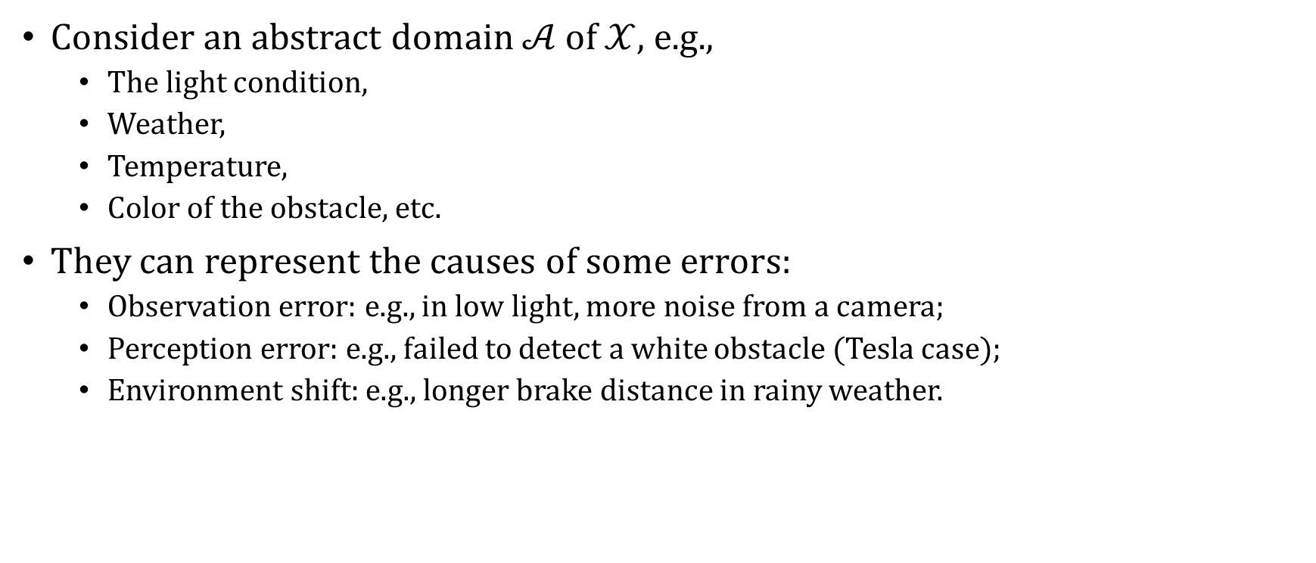
Abstraction of the Environment
$Consider$ an abstract domain $𝒜$ of $𝒳$, e.g.,
The light condition,
Weather,
Temperature,
Color of the obstacle, etc.
They can represent the causes of some errors:
Observation error: e.g., in low light, more noise from a camera;
Perception error: e.g., failed to detect a white obstacle (Tesla case);
Environment shift: e.g., longer brake distance in rainy weather.

Slide 23

Abstraction of the Observation
Consider an abstract domain $ℬ$ of $𝒪$, e.g.,
Gaussian noise,
Distortions,
Transformations,
Brightness, Contract, etc.
They can represent the causes of perception errors.

Slide 24
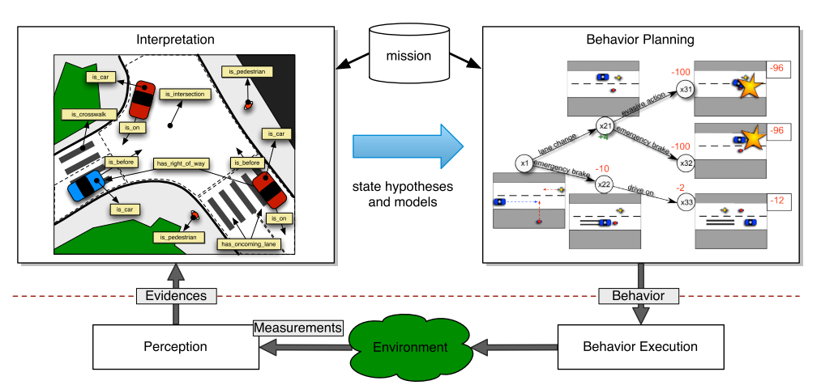
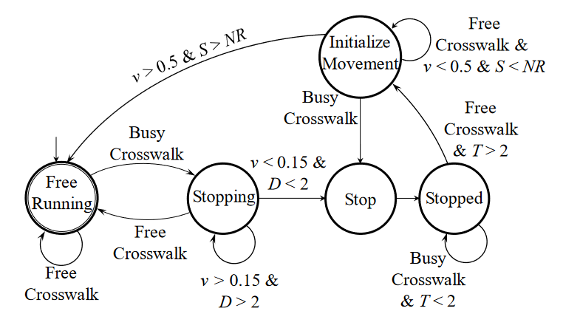
Abstraction of the Controller
Decision Making DOES use models (e.g., FSM, MDP)!
Model the dynamics of other traffic participants.
Deviations in these models can represent the environment shift.

Slide 25
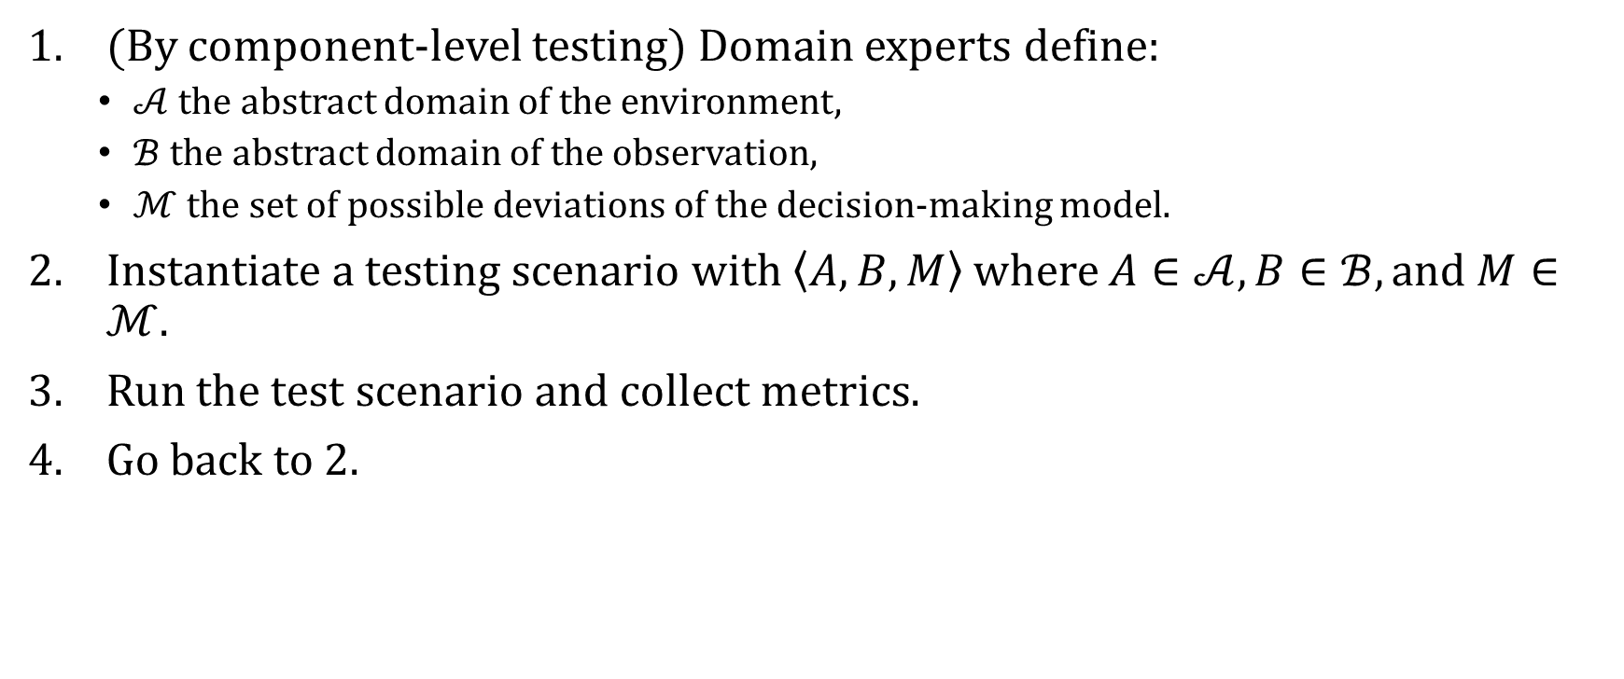
New Testing Procedure
(By component-level testing) Domain experts define:
$𝒜$ the abstract domain of the environment,
$ℬ$ the abstract domain of the observation,
$ℳ$ the set of possible deviations of the decision-making model.
Instantiate a testing scenario with $\left\langle A,B,M\right\rangle$ where $A∈𝒜, B∈ℬ, \text{and} M∈ℳ$.
Run the test scenario and collect metrics.
Go back to 2.

Slide 26
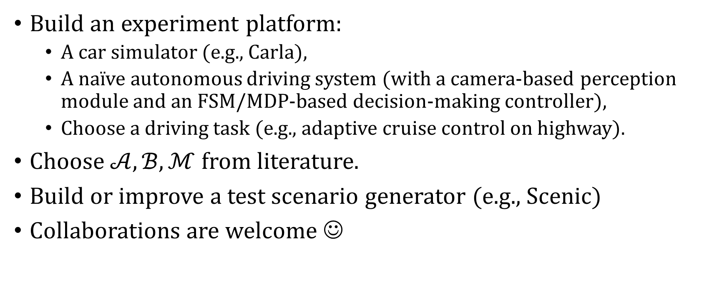
Research Plan
Build an experiment platform:
A car simulator (e.g., Carla),
A naïve autonomous driving system (with a camera-based perception module and an FSM/MDP-based decision-making controller),
Choose a driving task (e.g., adaptive cruise control on highway).
Choose $𝒜,ℬ,ℳ$ from literature.
Build or improve a test scenario generator (e.g., Scenic)
Collaborations are welcome ☺

Slide 27




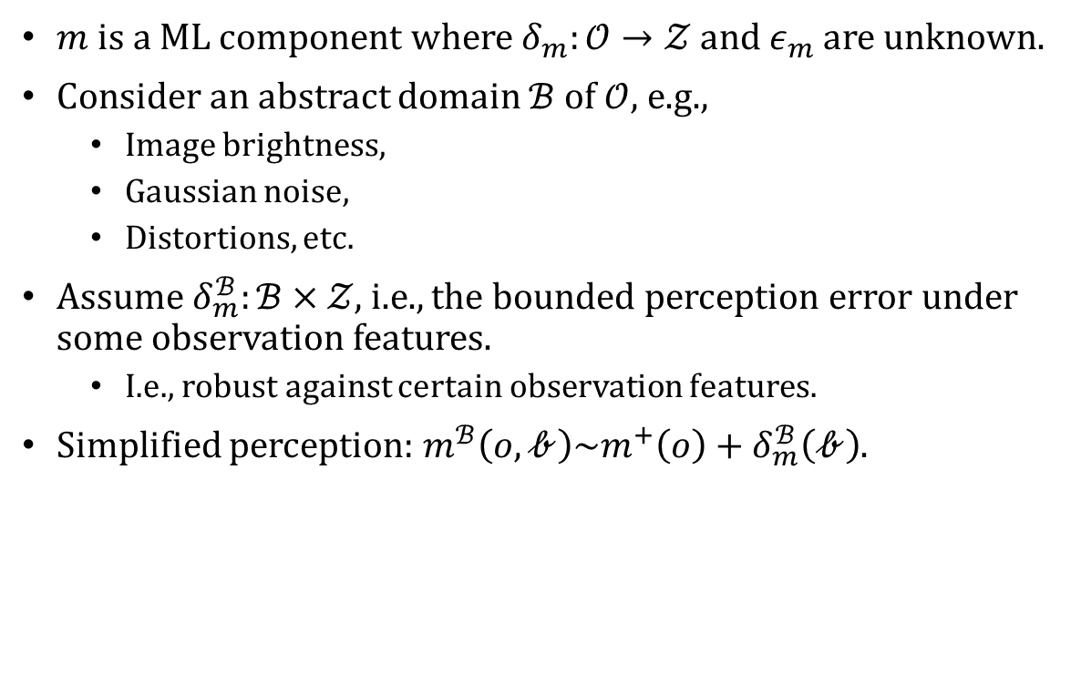



Abstraction of the observation
$m$ is a ML component where $δ_{m}:𝒪→𝒵$ and $ε_{m}$ are unknown.
Consider an abstract domain $ℬ$ of $𝒪$, e.g.,
Image brightness,
Gaussian noise,
Distortions, etc.
Assume $δ_{m}^{ℬ}:ℬ×𝒵$, i.e., the bounded perception error under some observation features.
I.e., robust against certain observation features.
Simplified perception: $m^{ℬ}\left(o,𝒷\right)\sim m^{+}\left(o\right)+δ_{m}^{ℬ}\left(𝒷\right)$.
$$m^{ℬ}:𝒪^{ℬ}→𝒵$$
$$π:𝒵→𝒰$$
$$Perception$$
$$z$$
$$Controller$$
$$o,𝒷$$
$$u$$
$$Observation$$
$$x,𝒶$$
$$Plant$$
$$h^{𝒜}:𝒳^{𝒜}×𝒪^{ℬ}$$
$$s^{𝒜}:𝒳^{𝒜}×𝒰×𝒳^{𝒜}$$
$$𝒪^{ℬ}=𝒪×ℬ$$
$$𝒳^{𝒜}=𝒳×𝒜$$

Slide 28

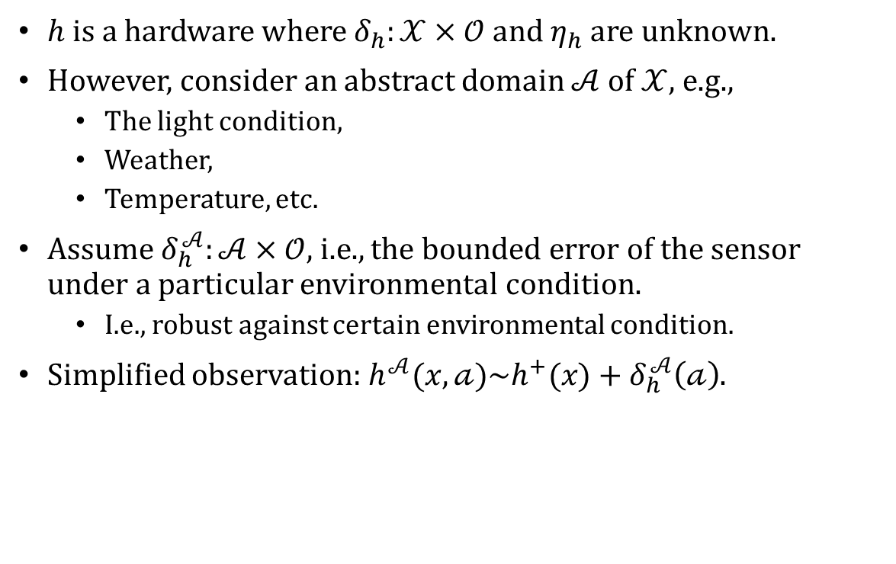

Abstraction of the environment
$h$ is a hardware where $δ_{h}:𝒳×𝒪$ and $η_{h}$ are unknown.
However, consider an abstract domain $𝒜$ of $𝒳$, e.g.,
The light condition,
Weather,
Temperature, etc.
Assume $δ_{h}^{𝒜}:𝒜×𝒪$, i.e., the bounded error of the sensor under a particular environmental condition.
I.e., robust against certain environmental condition.
Simplified observation: $h^{𝒜}(x,𝒶)\sim h^{+}(x)+δ_{h}^{𝒜}\left(𝒶\right)$.
$$m:𝒪→𝒵$$
$$π:𝒵→𝒰$$
$$Perception$$
$$z$$
$$Controller$$
$$o$$
$$u$$
$$Observation$$
$$x,𝒶$$
$$Plant$$
$$h^{𝒜}:𝒳^{𝒜}×𝒪$$
$$s^{𝒜}:𝒳^{𝒜}×𝒰×𝒳^{𝒜}$$
$$𝒳^{𝒜}=𝒳×𝒜$$

Slide 29



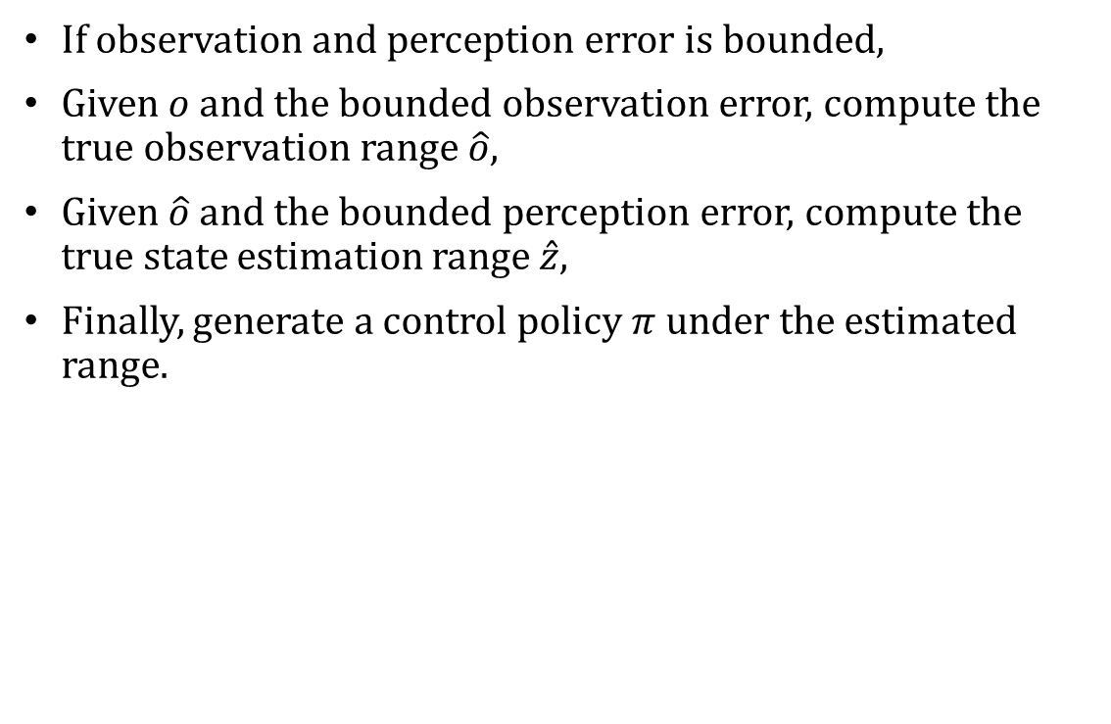







Control under observation and perception error
If observation and perception error is bounded,
Given $o$ and the bounded observation error, compute the true observation range $\hat{o}$,
Given $\hat{o}$ and the bounded perception error, compute the true state estimation range $\hat{z}$,
Finally, generate a control policy $π$ under the estimated range.
$$\hat{z_{0}}$$
$$\hat{z_{1}}$$
$$\hat{z_{2}}$$
$$𝒵_{safe}$$
$$𝒵$$
$$x_{0}$$
$$x_{1}$$
$$x_{2}$$
$$𝒳_{safe}$$
$$𝒳$$

Slide 30
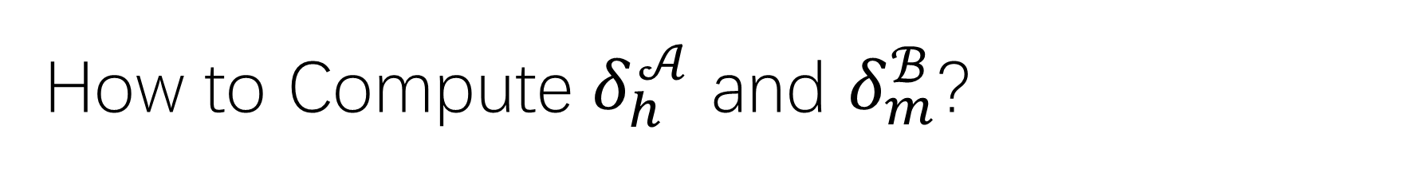
How to Compute $δ_{h}^{𝒜}$ and $δ_{m}^{ℬ}$?
TESTING!
Hardware industry has tons of mechanisms to test their products before shipping.
E.g., DxOMark, systematic customer review for smartphone cameras and lens.
Can we employ this to ML?
YES!
ML community know how input perturbations can affect the prediction,
But need to put them together systematically.
Notes:
Hardware industries they know how things can go wrong, how errors can happen, so they build systematic tests before shipping their products.

Slide 31

Design Time Safety Analysis
Given $δ_{h}^{𝒜}(𝒶)$ and $η_{h}$, compute the true observation range $\hat{o}$.
Given $δ_{m}^{ℬ}(𝒷)$ and $ε_{m}$, compute the true state estimation $\hat{z}$.

Slide 32
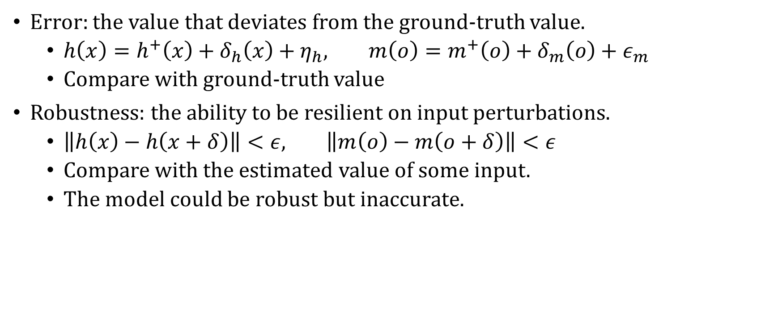
Robustness vs Accuracy
Error: the value that deviates from the ground-truth value.
$h\left(x\right)=h^{+}\left(x\right)+δ_{h}\left(x\right)+η_{h}, m\left(o\right)=m^{+}\left(o\right)+δ_{m}\left(o\right)+ε_{m}$
Compare with ground-truth value
Robustness: the ability to be resilient on input perturbations.
$\left\|h\left(x\right)−h\left(x+δ\right)\right\|<ε, \left\|m\left(o\right)−m\left(o+δ\right)\right\|<ε$
Compare with the estimated value of some input.
The model could be robust but inaccurate.

Slide 33
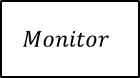
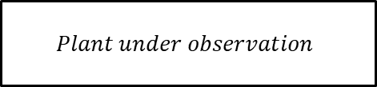
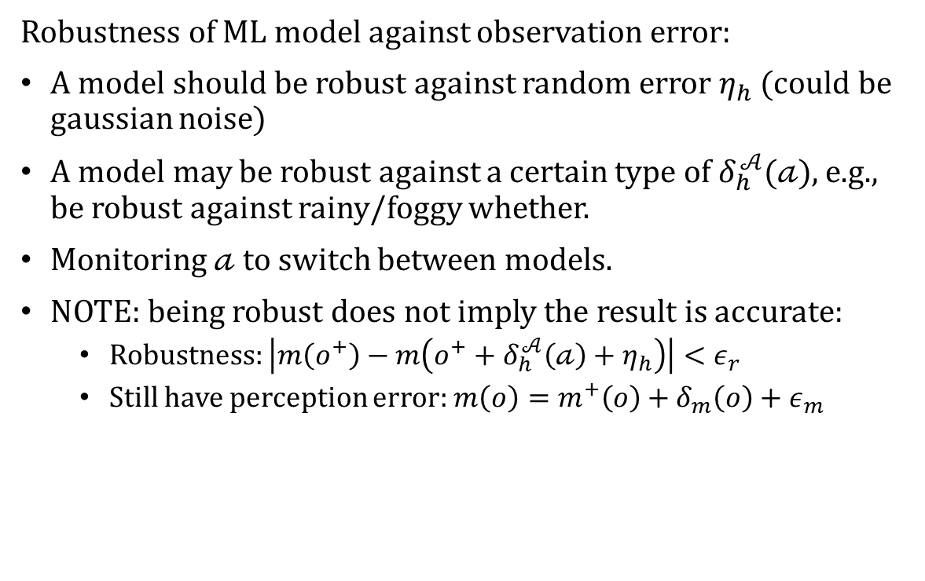




Safety monitor for perception
$$Monitor$$
Robustness of ML model against observation error:
A model should be robust against random error $η_{h}$ (could be gaussian noise)
A model may be robust against a certain type of $δ_{h}^{𝒜}(𝒶)$, e.g., be robust against rainy/foggy whether.
Monitoring $𝒶$ to switch between models.
NOTE: being robust does not imply the result is accurate:
Robustness: $\left|m\left(o^{+}\right)−m\left(o^{+}+δ_{h}^{𝒜}\left(𝒶\right)+η_{h}\right)\right|<ε_{r}$
Still have perception error: $m\left(o\right)=m^{+}\left(o\right)+δ_{m}\left(o\right)+ε_{m}$
$$m:𝒪→𝒵$$
$$π:𝒵→𝒰$$
$$Perception$$
$$z^{𝒶}$$
$$Controller$$
$$o^{𝒶}$$
$$u$$
$$Plant under observation$$
$$s^{𝒪}:𝒪×𝒰×𝒪$$
$$s^{𝒜}:𝒜×𝒰×𝒜$$
$$d^{𝒜}:𝒜×𝒜$$

Slide 34
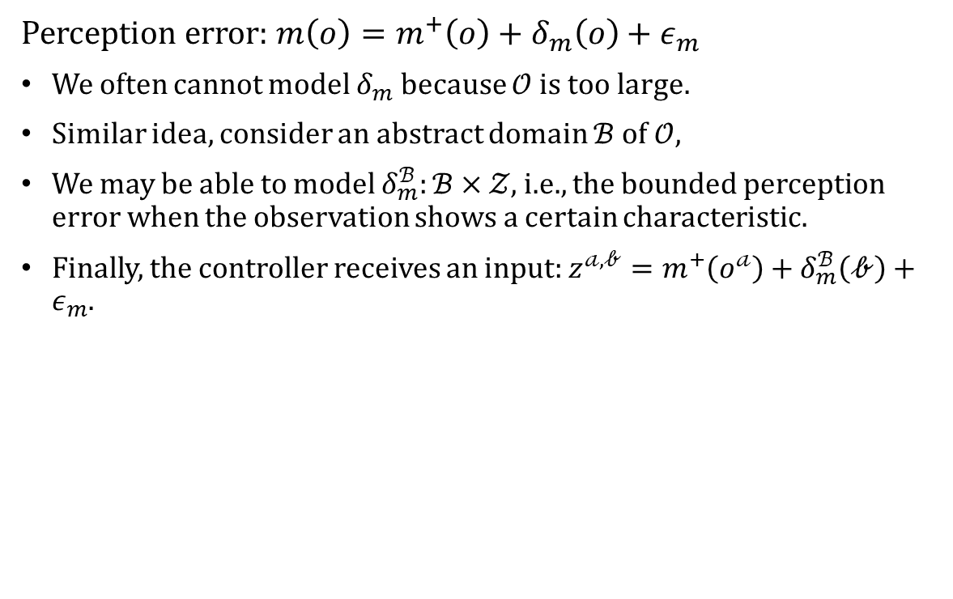


Abstraction of the observation
Perception error: $m\left(o\right)=m^{+}\left(o\right)+δ_{m}\left(o\right)+ε_{m}$
We often cannot model $δ_{m}$ because $𝒪$ is too large.
Similar idea, consider an abstract domain $ℬ$ of $𝒪$,
We may be able to model $δ_{m}^{ℬ}:ℬ×𝒵$, i.e., the bounded perception error when the observation shows a certain characteristic.
Finally, the controller receives an input: $z^{𝒶,𝒷}=m^{+}\left(o^{𝒶}\right)+δ_{m}^{ℬ}\left(𝒷\right)+ε_{m}$.
$$m:𝒪→𝒵$$
$$π:𝒵→𝒰$$
$$Perception$$
$$z^{𝒶,𝒷}$$
$$Controller$$
$$o^{𝒶}$$
$$u$$
$$Plant under observation$$
$$s^{𝒪}:𝒪×𝒰×𝒪$$
$$s^{𝒜}:𝒜×𝒰×𝒜$$
$$d^{𝒜}:𝒜×𝒜$$

Slide 35
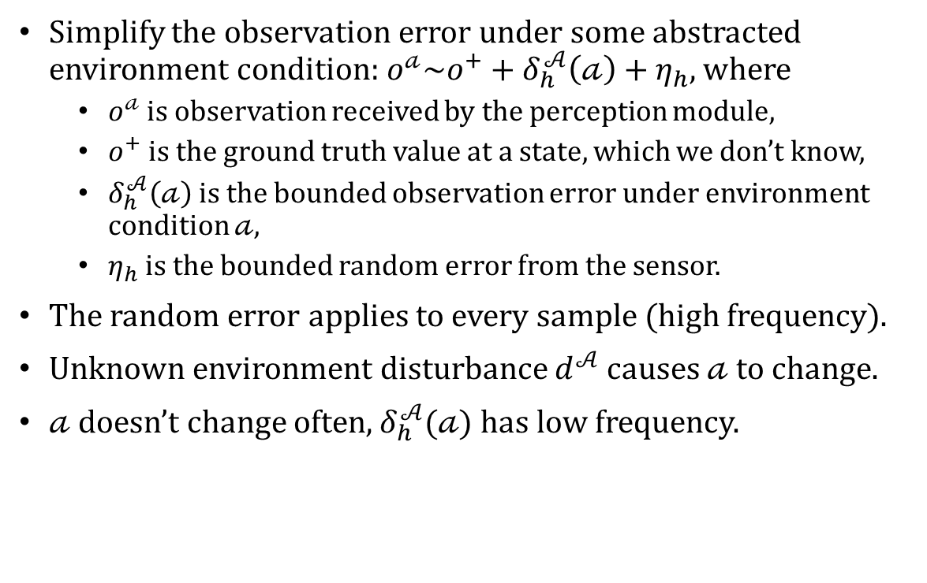
Simplified problem
Simplify the observation error under some abstracted environment condition: $o^{𝒶}\sim o^{+}+δ_{h}^{𝒜}\left(𝒶\right)+η_{h}$, where
$o^{𝒶}$ is observation received by the perception module,
$o^{+}$ is the ground truth value at a state, which we don’t know,
$δ_{h}^{𝒜}\left(𝒶\right)$ is the bounded observation error under environment condition $𝒶$,
$η_{h}$ is the bounded random error from the sensor.
The random error applies to every sample (high frequency).
Unknown environment disturbance $d^{𝒜}$ causes $𝒶$ to change.
$𝒶$ doesn’t change often, $δ_{h}^{𝒜}(𝒶)$ has low frequency.
$$m:𝒪→𝒵$$
$$π:𝒵→𝒰$$
$$Perception$$
$$z^{𝒶}$$
$$Controller$$
$$o^{𝒶}$$
$$u$$
$$Plant under observation$$
$$s^{𝒪}:𝒪×𝒰×𝒪$$
$$s^{𝒜}:𝒜×𝒰×𝒜$$
$$d^{𝒜}:𝒜×𝒜$$

Slide 36
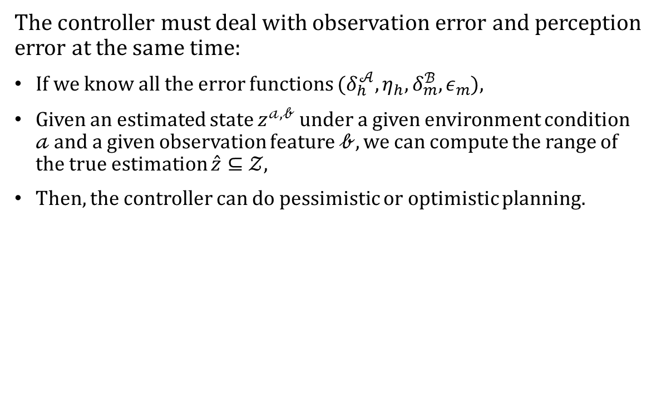
Propagation of error
The controller must deal with observation error and perception error at the same time:
If we know all the error functions ($δ_{h}^{𝒜}, η_{h}, δ_{m}^{ℬ}, ε_{m}$),
Given an estimated state $z^{𝒶,𝒷}$ under a given environment condition $𝒶$ and a given observation feature $𝒷$, we can compute the range of the true estimation $\hat{z}⊆𝒵$,
Then, the controller can do pessimistic or optimistic planning.
$$m:𝒪→𝒵$$
$$π:𝒵→𝒰$$
$$Perception$$
$$z^{𝒶,𝒷}$$
$$Controller$$
$$o^{𝒶}$$
$$u$$
$$Plant under observation$$
$$s^{𝒪}:𝒪×𝒰×𝒪$$
$$s^{𝒜}:𝒜×𝒰×𝒜$$
$$d^{𝒜}:𝒜×𝒜$$

Slide 37
Propagation of error
However, in practice, observation module and perception module may be compositions of sub-components,
The error functions after the composition become unknown or become dramatically harder to compute.
$$m:𝒪→𝒵$$
$$π:𝒵→𝒰$$
$$Perception$$
$$z^{𝒶,𝒷}$$
$$Controller$$
$$o^{𝒶}$$
$$u$$
$$Plant under observation$$
$$s^{𝒪}:𝒪×𝒰×𝒪$$
$$s^{𝒜}:𝒜×𝒰×𝒜$$
$$d^{𝒜}:𝒜×𝒜$$

Slide 38


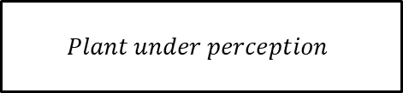

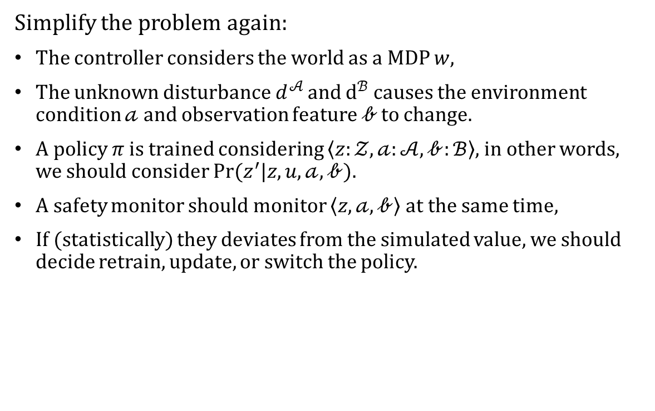
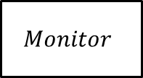

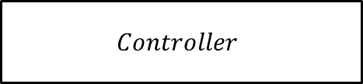


Simplified problem v2
$$Monitor$$
Simplify the problem again:
The controller considers the world as a MDP $w$,
The unknown disturbance $d^{𝒜}$ and $d^{ℬ}$ causes the environment condition $𝒶$ and observation feature $𝒷$ to change.
A policy $π$ is trained considering $\left\langle z:𝒵, 𝒶:𝒜,𝒷:ℬ\right\rangle$, in other words, we should consider $Pr⁡(z^{′}|z,u,𝒶,𝒷)$.
A safety monitor should monitor $\left\langle z, 𝒶,𝒷\right\rangle$ at the same time,
If (statistically) they deviates from the simulated value, we should decide retrain, update, or switch the policy.
$$π:𝒵→𝒰$$
$$Controller$$
$$z^{𝒶,𝒷}$$
$$u$$
$$Plant under perception$$
$$s^{𝒵}:𝒵×𝒰×𝒵$$
$$s^{𝒜}:𝒜×𝒰×𝒜$$
$$s^{ℬ}:ℬ×𝒰×ℬ$$
$$d^{𝒜}:𝒜×𝒜$$
$$d^{ℬ}:ℬ×ℬ$$

Slide 39
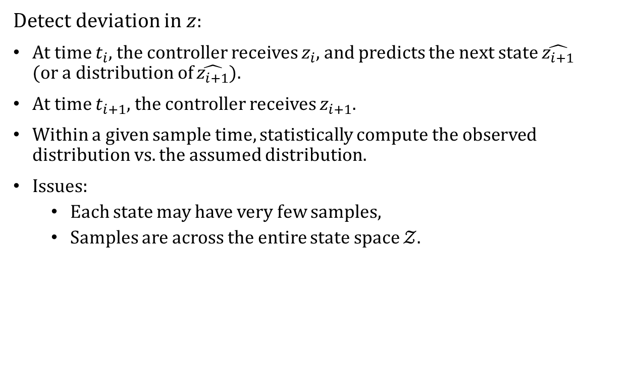

Monitoring state transitions
$$Monitor$$
Detect deviation in $z$:
At time $t_{i}$, the controller receives $z_{i}$, and predicts the next state $\hat{z_{i+1}}$ (or a distribution of $\hat{z_{i+1}}$).
At time $t_{i+1}$, the controller receives $z_{i+1}$.
Within a given sample time, statistically compute the observed distribution vs. the assumed distribution.
Issues:
Each state may have very few samples,
Samples are across the entire state space $𝒵$.
$$π:𝒵→𝒰$$
$$Controller$$
$$z^{𝒶,𝒷}$$
$$u$$
$$Plant under perception$$
$$s^{𝒵}:𝒵×𝒰×𝒵$$
$$s^{𝒜}:𝒜×𝒰×𝒜$$
$$s^{ℬ}:ℬ×𝒰×ℬ$$
$$d^{𝒜}:𝒜×𝒜$$
$$d^{ℬ}:ℬ×ℬ$$

Slide 40







Monitoring state transitions
$$Monitor$$
Does not work if the state estimation is always shifted, and the observed distribution conforms to the assumed one.
E.g., the system is at $A$, but the controller thinks it is at $A’$, and the observed distribution conforms to the assumed distribution. So, the controller may think $C’$ is safe, however, it leads the system to unsafe state $C$.
However, if we consider $Pr⁡(z^{′}|z,u,𝒶,𝒷)$, we may discover the environment change causing this global shift.
$$π:𝒵→𝒰$$
$$Controller$$
$$z^{𝒶,𝒷}$$
$$u$$
$$Plant under perception$$
$$C′$$
$$C$$
$$A′$$
$$A$$
$$s^{𝒵}:𝒵×𝒰×𝒵$$
$$s^{𝒜}:𝒜×𝒰×𝒜$$
$$B′$$
$$B$$
$$s^{ℬ}:ℬ×𝒰×ℬ$$
$$d^{𝒜}:𝒜×𝒜$$
$$d^{ℬ}:ℬ×ℬ$$

